Slide 1



Data Questers
Title:
“A Comparative Study of Renewable Energy Adoption Across Various Countries”
GROUP 6
2025 G.C
WOMEN TECHSTERS BOOTCAMP COHORT 4.0

Slide 2
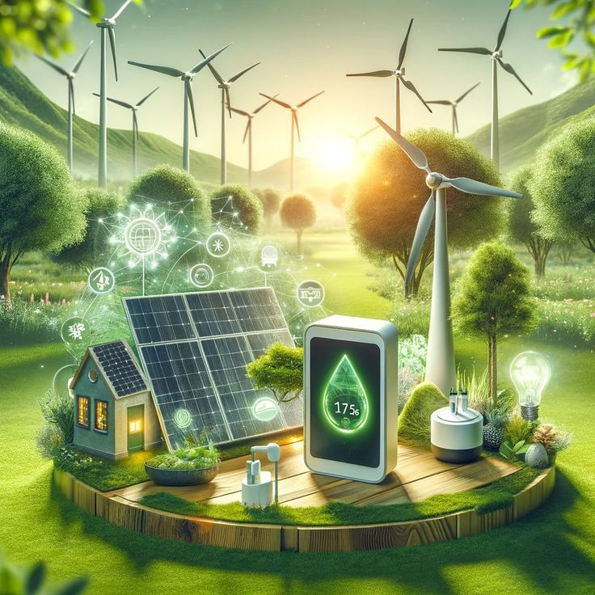
Table of Contents
Introduction
Objectives
Methodology
Analysis
Visual Representation
Insights
General Recommendations
Conclusion

Slide 3





Introduction
This report looks at how countries around the world use and produce energy. We compared energy data from 176 countries between 2000 and 2020.
It focuses on:
Goal
Access to electricity
Use of renewable (clean) energy
Dependence on fossil fuels
CO₂ emissions and pollution
Identify challenges
faced by different regions
Help guide better decisions
for a cleaner future
Show progress in
using clean energy

Slide 4





Objective
Compare how different countries are adopting renewable (clean) energy
Spot differences across regions and understand what helps or slows down renewable energy growth
Study the link between clean energy use and economic factors
Check progress towards Sustainable Development Goal 7 - Affordable and Clean Energy for All.
Excel
Power Query Editor
Data Visualization:
Power BI
Data Source
Notes:
add statistics for the charts

Slide 5

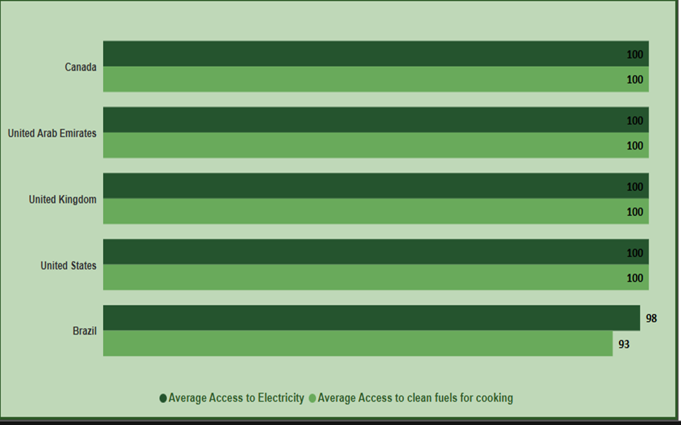
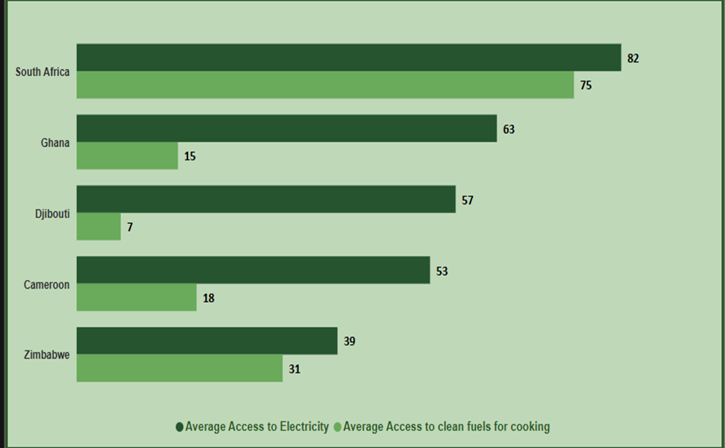
Analaysis
ELECTRICITY ACCESS AND CLEAN FUEL COMPARISON: LEADING FIVE COUNTRIES WORLDWIDE AND IN AFRICA
WORLDWIDE
AFRICAN COUNTRIES

Slide 6
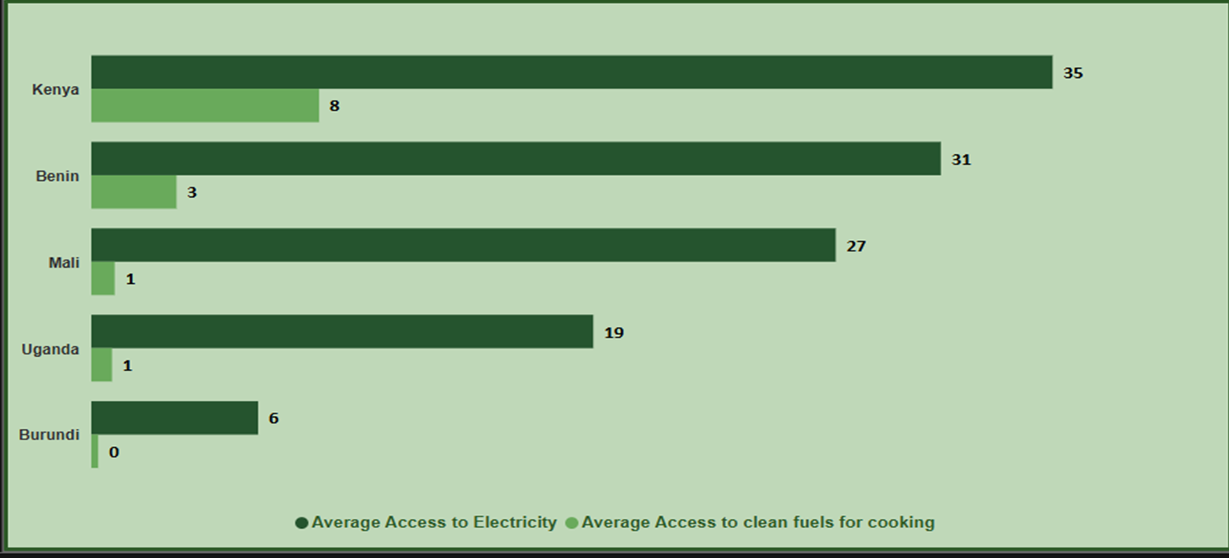

LOWEST-RANKED COUNTRIES IN ELECTRICITY ACCESS

Slide 7
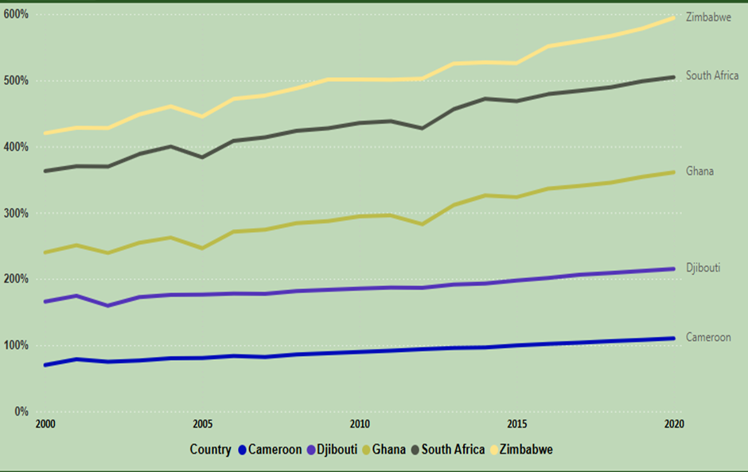
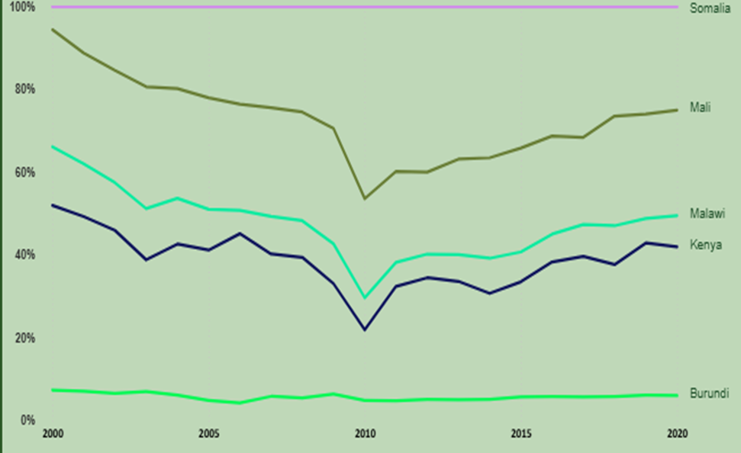
ELECTRICITY USAGE COMPARISON: LEADING FIVE COUNTRIES AND BOTTOM FIVE COUNTRIES IN AFRICA
Bottom 5 African Countries
Top 5 African Countries

Slide 8
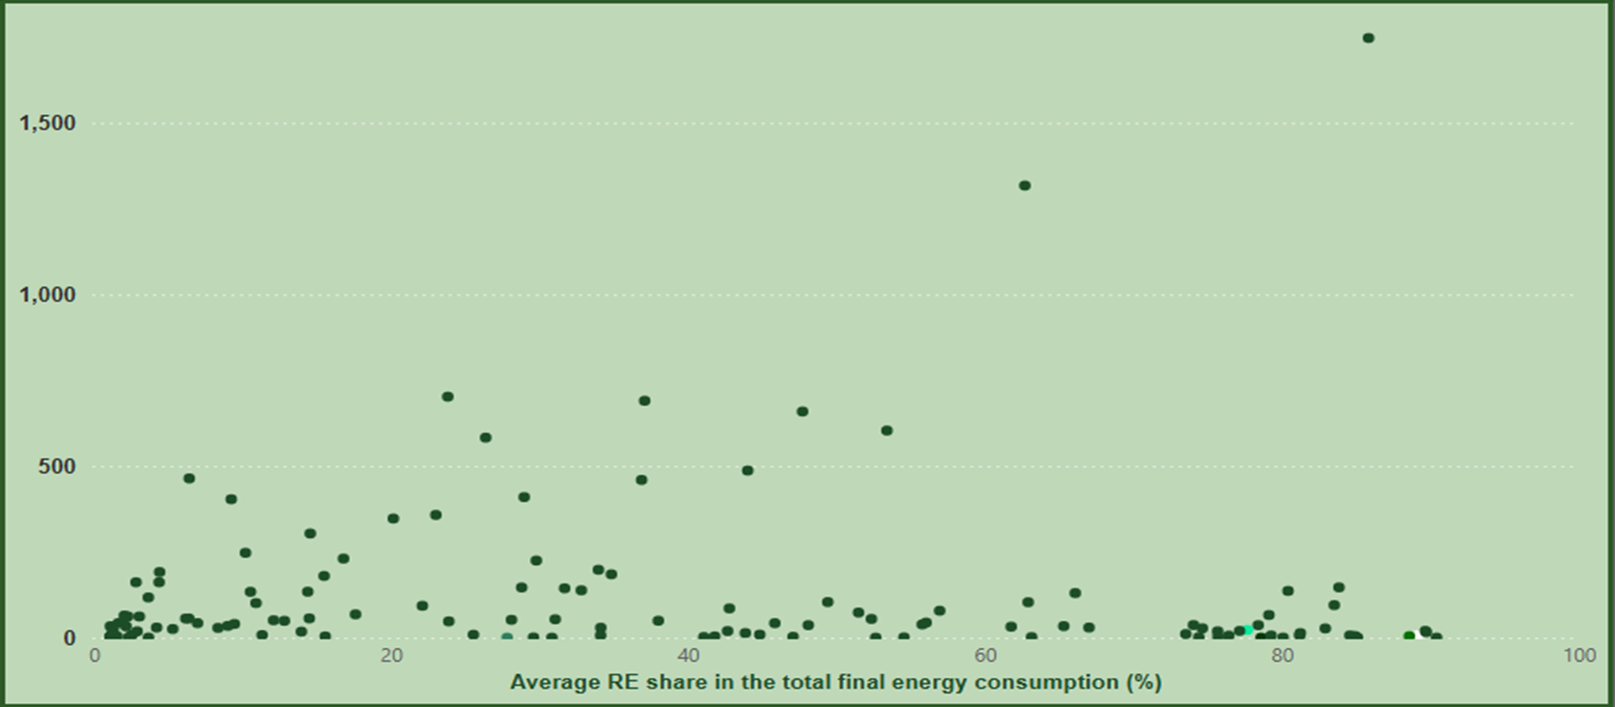
EVALUATION OF CORRELATION PATTERNS IN RENEWABLE ENERGY DATA

Slide 9
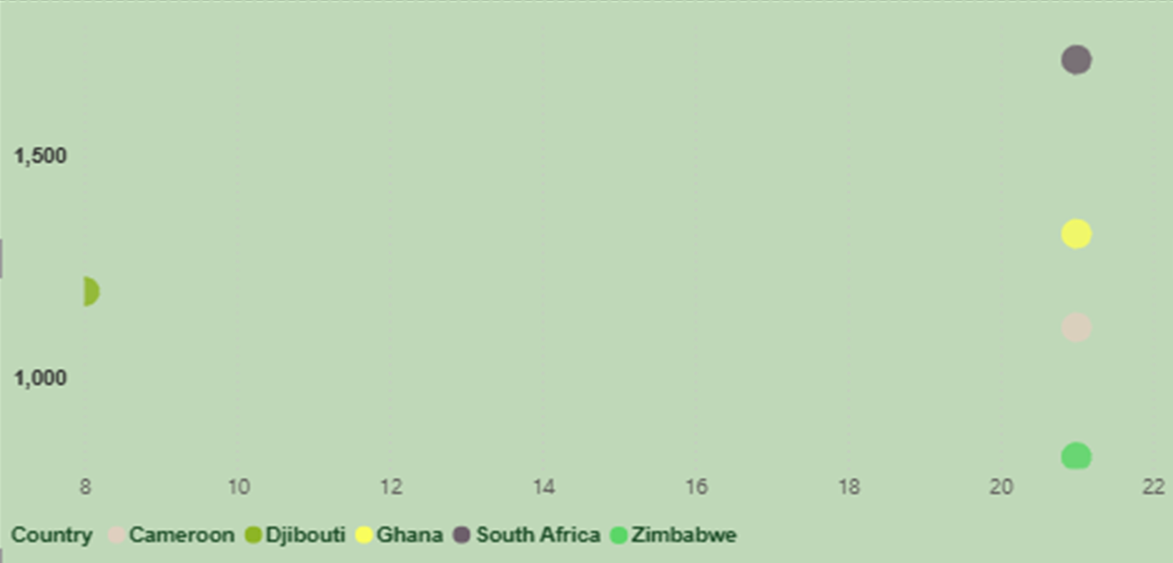
ELECTRICITY ACCESS AND GDP GROWTH AMONGST THE TOP 5 AFRICAN COUNTRIES

Slide 10
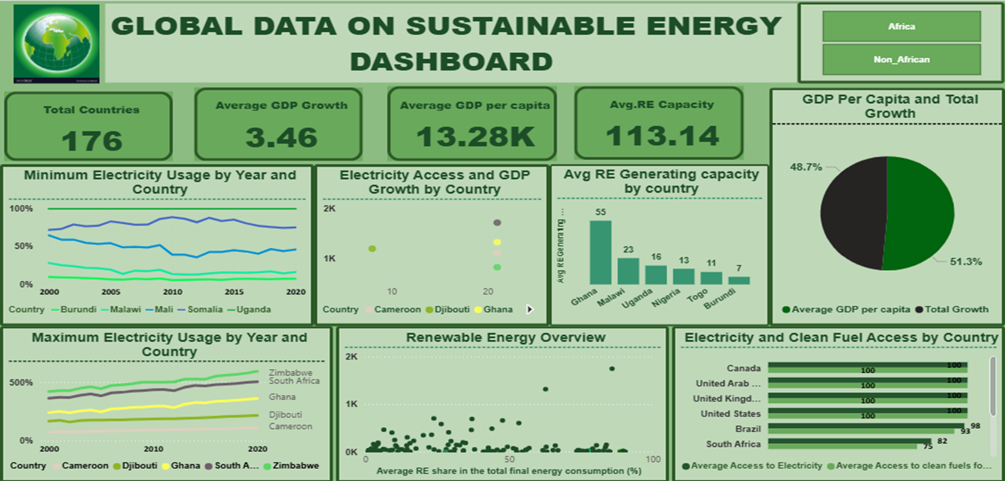
VISUAL REPRESENTATION

Slide 11
Insights
🌍 Big gap in electricity access: Richer countries have much better access than poorer ones.
🌐 Africa is behind: Many African countries struggle with low renewable energy levels due to limited infrastructure.
💰 Money matters: Countries with higher income per person invest more in clean energy.
♻️ Renewable energy reduces pollution: Countries using more renewables produce less CO₂.
📊 Electricity access leads to faster progress: Countries with steady electricity access grow their clean energy faster.

Slide 12
⚡
🤝
Support low-income countries by helping them expand electricity access - especially in parts of Africa.
💵
Promote teamwork between countries - sharing knowledge, tools, and clean energy technology.
Encourage clean energy investments through tax breaks, grants, or government funding.
📈
Plan for the long term by balancing today’s energy needs with future environmental goals.
🧩
Create energy plans that fit each country’s needs - based on their economy and energy levels.
GENERAL RECOMMENDATIONS

Slide 13

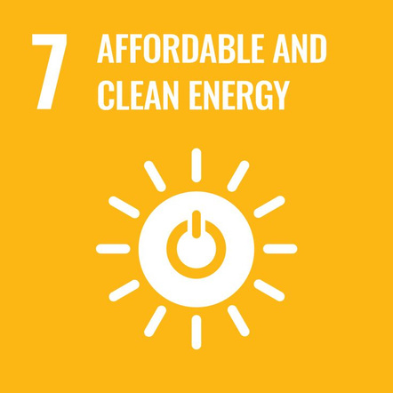


Conclusion
🌍 The world is making progress in using clean, renewable energy, but many countries are still falling behind.
💡 To achieve Sustainable Development Goal 7, we need strong policies, more investment, and global teamwork.
📊 Countries must balance short-term needs (like basic electricity access) with long-term clean energy goals.
✅ With the right actions, everyone - no matter where they live - can have access to affordable and reliable energy.

Slide 14
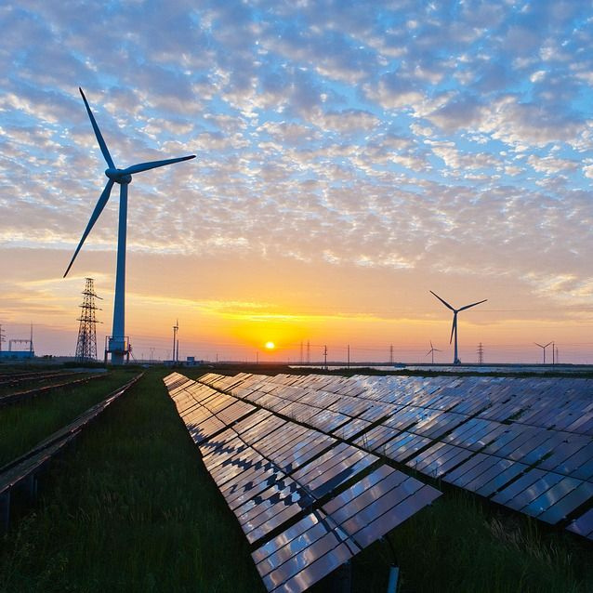
Data questers - Group 6
Thank you !

